Slide 1
Welcome
Notes:
1 min
Welcome. I’m Glenn Harmon and I’m a Data Management Specialist/ETL Developer for CoverMyMeds.
I’m a husband and a father to two beautiful preteen girls. The emphasis there being on preteens who think they’re already adults. If you’re wondering what would make someone get up on stage and talk to people, I figured a group of strangers were more likely to listen to me then they are.
My being a father and husband is relevant because they are the love of my life. My wife and I tend to watch Friends on Nick at Nite which mean you’ll have to suffer through some of these.

Slide 2

Notes:
I’m old enough to have watched this live and now have lived long enough to watch this become ‘Classic’ TV
Also because I’m father a dad joke might slip out here and there. Sorry, not sorry.

Slide 3
Places to find me
https://github.com/gharmonjr/codemash
Twitter
@glennharmonjr
Instagram
@glennharmonjr
LinkedIn
Glenn Harmon Jr.
Notes:
30
You can find me on Twitter @glennharmonjr
I mostly talk about Star Wars, sports the such as the Cavs or how the Browns are taking years off of people’s lives and movies good or bad. For instance how the commuter staring Liam Neeson looks more like Taken 4 or Taken on a train and occasionally comment on something political, I used to do this more but I’ve tired myself out.
I’m also on instagram @glennharmonjr if you want to see pictures of kids or Star Wars or my causal attempts to be a photographer and LinkedIn as Glenn Harmon Jr

Slide 4
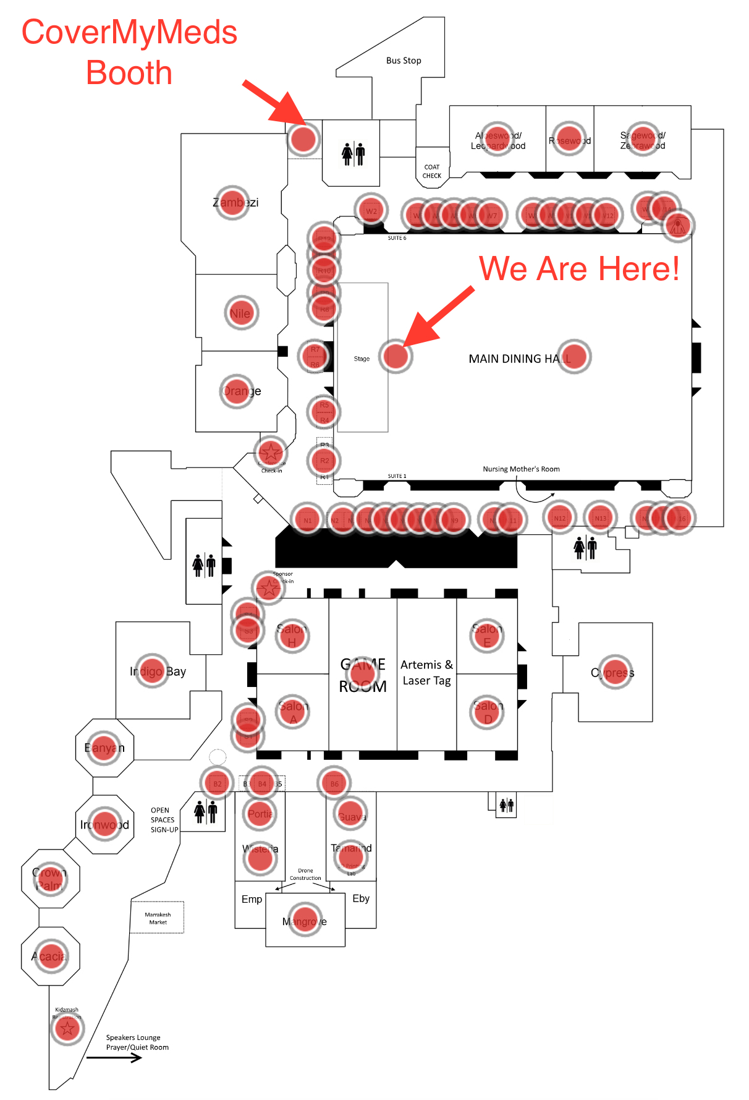
CoverMyMeds
Notes:
In case you were unsure we where are I’ve marked us and then the location of the CoverMyMeds booth
If you stop by the booth you can pickup a pair of these awesome socks.

Slide 5







Best Place to Work
Named one of the top 50 places to work in the nation in Glassdoor’s annual Employee’s Choice Awards
#1 Large Employer in Columbus (Business First, Columbus CEO)
Exceptional Retention Rate and Employee Referral Volume
https://www.covermymeds.com/main/careers/
Notes:
As you might have gathered from me already saying this or since this is a sponsor session or from the copyright information in the bottom right of my slides I work at CoverMyMeds.
I think it’s cool place to work but you don’t have to take my word for it

Slide 6
Do you know what happens to your data after you create it?
Notes:
The title of today’s talk is ‘Do You Know What Happens to Your Data After You Create It’.
What I do at CMM
responsible for using ETL tools to move data around production and analytics environments.
also responsible for bringing in outside data that didn’t originate with us. A simple example of that would be zip code data.
Devs, Analysts, DBAs, Marketing, Product Owners, etc.
From the time an idea is formulated to the time its launched- can we take a proactive approach to consumable data.

Slide 7
By taking a proactive approach to consumable data we can save our organization, as a whole, lots of time.
THE GOAL
Notes:
By taking a proactive approach to consumable data we can save our organization, as a whole, lots of time.
By extension it will save us a lot of time too.
Less questions in the long run.
More self serve setups

Slide 8

Things we are going to talk about
How being proactive can help
Common myths we tell ourselves
How we can get more from our data
Things most likely to cause a fight
Approach to creating data not much different than data retrieval
What can we do now?
Notes:
How being proactive can help
Common myths we tell ourselves
How we can get more from our data
Things most likely to cause a fight
Approach to creating data not much different than data retrieval
What can we do now?
I have 35 mins worth of talking for a 45 mins slot. This means we have time during the presentation that if you have any questions or comments we don’t have to wait to the end.
And to entice you I’ve brought some sweatshirts and beanies to give away.
I’ll also preface this with saying I don’t have all the answers. Only some of them. Some of you might feel scammed once you’ve sat through this. Some of you might even feel like you know less. You’re welcome.

Slide 9
How can being proactive help?
Notes:
If organizations could just get more and better information, they could use data science and analytics to do amazing things.
But the journey from building a data warehouse, to getting clean data into it, to making sure it’s protected, to finally getting it into the right people’s hands is a long one.
Our modern tools make it easy to analyze the data and they are some of the best we’ve ever had, but for true self-serve, you have to make the data accessible.
You need to cleanse, index, and catalog the data so researchers can find it, and then protect private information. This “missing link” can lead to significant delays.
Many of these processes are manual and inefficient, when it doesn’t have to be.
For example, one big challenge is just knowing what to ask for
Suppose an analyst or researcher wants to conduct a particular investigation. They have to put in a dataset request to the analytics team, specifying inclusion/exclusion criteria and fields of interest. Once that dataset is produced, the investigation often leads to missing fields of interest. What initially seemed a straightforward request quickly bogs down to a cumbersome process that can take weeks.
This is an example that you pay for this someplace. If it’s not addressed up front you’ll pay for it somewhere

Slide 10
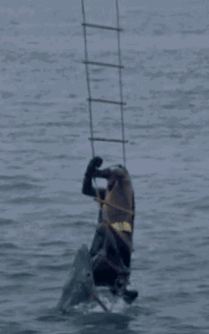
Notes:
This is here because a friend challenged me to include this gif. We’ll say that being proactive in this instance is less about batman freeing himself from the shark and more about what he could have done to avoid the shark infested waters to begin with.

Slide 11

Notes:
When we don’t take a proactive approach it often works out to be similar to buy a couch without taking the time to make sure it fits.

Slide 12

How to get more from our data
Can we make data more consumable with some up front effort
Getting All The Data In One Place: Do we know where this data is stored? Is it the most recent copy?
Index And Catalog: Creating resources to help drive accountability and Data governance
Control Access At The Data Level: This is important because not everyone needs access to all data
Notes:
How we can get more from our data
We’re going to talk about three ways we can attempt to make data more consumable upfront and to mitigate some of the time cost when it comes to retrieving this data.
Getting all data in one place
Again this is the presumption that we are coming in from day one and we are in the planning stages.
The first thing that will slow down the data retrieval process is not knowing where to find the data at all.
Index and Catalog
Creating resources to help drive accountability
Control Access at the data level
This is important because not everyone needs access to all data
Again, the more of this we address up front the more likely we can pay for this once instead of each time we need to use this data differently or in a different location

Slide 13
Reduce manual process and inefficiencies to decrease turnaround time and increase accuracy
GET ALL THE DATA IN ONE PLACE
Notes:
The first thing that will slow down the data retrieval process is not knowing where to find the data at all.
If you get a request to know the volume of payments thru a certain time period, not knowing where that information lives and how much of it lives there will hinder our ability to produce consumable data.
Will there be a reporting server that will house this information? A Data warehouse? Both?
How up to date will the data be?
Are there multiple versions of this data
Will we archive the data someplace else? Where?
Where appropriate automating as much of the process of moving data to the correct locations as possible. If you can remove the manual portions here reliably then you can remove questions such as did someone refresh this data recently? Do we know how data gets from point A to point B?

Slide 14
Create and maintain resources that drive accountability
INDEX AND CATALOG
Notes:
Creating resources to help drive accountability
people go on vacation
systems become more complex
More devs, analysts, people in the organization in general
This is about systems and procedure in place so it doesn’t fall to one person to know or house all this information
Data Governance
While this will be simpler said than done, this comes down to getting the right people, at the right time, doing the right thing

Slide 15



Right People, Right Time, Doing the Right Thing
Even before we begin implementing an idea there are things we can do to put ourselves in a position to be more proactive.
Right People?
Devs, Analysts, Marketing, Any Other Stakeholders
Right Time?
During the planning phase before implementation
Right Things?
Creating a communication strategy
Notes:
Right people?
This could be stakeholders. Developers. Analysts. Marketing, etc.
Right Time?
In an ideal scenario this would be during the planning phase.
But this could be before adding a new feature or data element
Doing the right things?
Creating a communication strategy
Where will this knowledge live
I can only speak from experience but I have been in some companies where knowledge is tribal or only communicated verbally.
Can this knowledge live in a shared drive or in app. Can people readily access it?
Determining Acceptable use
Determining if the Data is usable
Standards and definitions
Monitor for valid values
Data Dictionary
Client Naming Conventions

Slide 16
Not everyone needs access to all the data just because it’s available
CONTROL ACCESS AT THE DATA LEVEL
Notes:
This is important because not everyone needs access to all data
Likewise even if they do there might be presentations methods that accomplish both the goal of controlling access and providing clarity
For example. Patient or customer information. Do we really need to expose SSN to our analysts or researchers? The answer is likely, no.
So what can you do here? For purposes of being able to display the data back to an end user you might store this information is two ways.
App specific usage. If a customer/patient needs to update their name do those needing to consume data need that info?
What if the data was provided to those that needed to consume by hashing it. Then they could always tie back any relevant information to the correct hash without knowing who that hash belongs to.
Again, the more of this we address up front the more likely we can pay for this once instead of each time we need to use this data differently or in a different location

Slide 17
Notes:
Talk about how having a data dictionary is helpful

Slide 18
Common Myths
Notes:
First let’s start with some common myths that we’ve heard along the way or things we tell ourselves that we know we shouldn’t.

Slide 19
Notes:
Common myth or misconception
It’s moot. Not mute. And certainly not moo like our friend Joey thinks.

Slide 20

Things we might have run across a time or two
It works just fine on my machine
The warehouse will solve these problems
We can add it in a notes field
Mongo has a solution for this
This is just auditing data/no cares about this data
we will never use it/read it
It’s defined in the code
That sounds simple it should only take five mins
Notes:
It works just fine on my machine
The warehouse will solve these problems
We can add it in a notes field
Mongo has a solution for this
This is just auditing data/no cares about this data
we will never use it/read it
It’s defined in the code
That sounds simple it should only take five mins
Ask question to the tables here about myths they might have found or experienced for a shirt or beanie

Slide 21
The Section Most Likely To Cause A Fight
Notes:
Aptly titled because the bullet points in this section are a good way to get a dev of dba’s blood boiling in a hurry

Slide 22
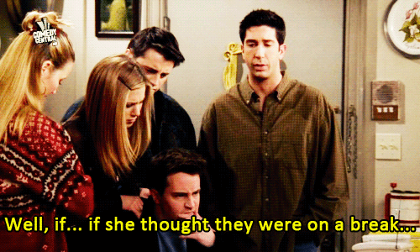
Notes:
However right Ross was or wasn’t he knew that every time he brought up the phrase “we were on a break” that it was likely to start a fight

Slide 23
Things we might have run across a time or two
JSON vs Normalization
Notes:
JSON vs normalization
? Becomes NoSQL vs. a relational database.
Relational fairly flat hierarchies, no weird data types like images or audio, predictable relationships between the schemas that can be easily described in keys, and you anticipate eventually needing include people who want to do Business Intelligence queries (ad hoc querying), then an RDBMS is the way to go.
It's fairly easy to turn a query into a JSON representation, so it doesn't significantly burden your Ajax consumers -- it just adds a little transformation coding into your endpoints (REST/SOAP/whatever).
Conversely, if your data is very hierarchical (deep schemas), contains weird data types like images, audio, video, etc., there are few relationships between entities, and you know that your end users will not be doing BI, then NoSQL/storing JSON may be appropriate

Slide 24
Things we might have run across a time or two
JSON vs Normalization
Normalization vs Practicality
Notes:
Normalization vs practicality
The bottom line is that you should normalize your database unless you have a really good reason not to do so.
Database normalization protects your data's integrity.
Normalizing is usually sound design practice.
It reduces redundant information, optimizes performance and reduces the likelihood that you’ll have data integrity issues that result from having the same data stashed in different corners of your database.

Slide 25
Things we might have run across a time or two
JSON vs Normalization
Normalization vs Practicality
Reserved Words
Notes:
Reserved words
If you have to qualify your word/term in your code then there is a realistic chance it has to be qualified on the consumable data side. Save yourself future time here by not using reserved words. If you have to qualify it every place you use it you’re costing yourself time.
Additionally, reserved words are more generic. Such as name, order, select, and, begin. Not only might you have to qualify these words but they aren’t descriptive to what you’re trying to accomplish. It doesn’t tell anyone who may look at the data this is named after what it’s purpose is either.
Example, instead of using just name you could use company name, or first name

Slide 26
Things we might have run across a time or two
JSON vs Normalization
Normalization vs Practicality
Reserved Words
Soft vs Hard Deletes
Notes:
There will inevitably be a time when we need to inactivate data.
Done in two ways. soft vs hard deletes
Hard delete is where we destroy the record as if it never existed
Soft delete is where we use an additional column to indicate the record is no longer relevant. This could be a date field or bit flag
When we hard delete data we create unexplainable gaps in the data on the consumable data side
Why did the counts change
Trends might be different
Destroying this data rather than inactivating it

Slide 27
Things we might have run across a time or two
JSON vs Normalization
Normalization vs Practicality
Reserved Words
Soft vs Hard Deletes
Integer vs Guid Primary Key
Notes:
integer vs guid primary key
GUID Pros
Unique across every table, every database and every server
Allows easy merging of records from different databases
Allows easy distribution of databases across multiple servers
You can generate IDs anywhere, instead of having to roundtrip to the database
Most replication scenarios require GUID columns anyway
GUID Cons
It is a whopping 4 times larger than the traditional 4-byte index value; this can have serious performance and storage implications if you're not careful
Cumbersome to debug (where userid='{BAE7DF4-DDF-3RG-5TY3E3RF456AS10}')
The generated GUIDs should be partially sequential for best performance (eg, newsequentialid() on SQL 2005) and to enable use of clustered indexes
Integer Pros
Smaller
sequential
Performant
Integer Cons
Not unique amongst tables
Total number limit

Slide 28
Things we might have run across a time or two
JSON vs Normalization
Normalization vs Practicality
Reserved Words
Soft vs Hard Deletes
Integer vs Guid Primary Key
Polymorphic Tables
Notes:
polymorphic tables
reusing tables for more than one purpose
From a data storage perspective this might be seen as a quick solution.
However what this does is create logic that is not readily apparent outside of the code.
Issues can arise when you need to expand on that table and keeping the rules consistent
So the time saved can be costly when it comes time to expand
These conditions also have to be translated when it pulls
For the remaining hats and shirts anything else that you feel causes a big rift between departments that we didn’t cover

Slide 29

Approach to coding not much different than data retrieval
Both involve solving problems
Notes:
High level
Well, they both involve solving problems
Both have to look at the solution as a whole as well as think about the outliers

Slide 30
Approach to coding not much different than data retrieval
Both involve solving problems
Performance considerations
Notes:
Both consider performance (or at least should).
The same way we believe it harms the user experience when they have to spend unnecessary time at a loading screen, the same way a business end user feels if they attempt to pull self generated report and have to way some undetermined amount of time

Slide 31
Approach to coding not much different than data retrieval
Both involve solving problems
Performance considerations
Best practices overlap
Notes:
Some best practices overlap between the two
Naming of methods vs naming of stored procedures
Naming of variables
Keep it simple
Broken down into smaller more manageable sizes
They both use can utilize version control
And have multiple people contributing
They can both be hard to follow if documented poorly. Even within the code
Both often need refinement
Test driven

Slide 32
Approach to coding not much different than data retrieval
Both involve solving problems
Performance considerations
Best practices overlap
Storage
Notes:
Both have to consider storage and reusability

Slide 33
Approach to coding not much different than data retrieval
Both involve solving problems
Performance considerations
Best practices overlap
Storage
Target Audience
Notes:
Both have to understand the target audience
These are just a few;
* For a shirt or beanie are there other scenarios that these two might be comparable? *
We’ve all been in situations where it doesn’t feel like one side doesn’t know what the other side needs/wants.

Slide 34
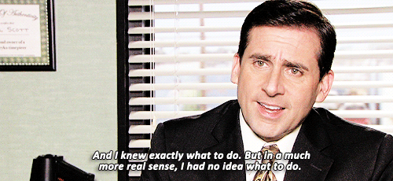
Notes:
So what can we do with all of this information?

Slide 35




What can we do right now?
STEP ONE: FIND PEOPLE THAT CARE ABOUT BEING RESPONSIBLE FOR DATA
Even if it’s just in your own department to begin with. Building a mentality and a culture has to start someplace.
STEP TWO: FIND OUT WHO IN LEADERSHIP SUPPORTS DATA ACCOUNTABILITY
And if there is no one begin by showing some of the benefits. Such as how we can produce this one thing faster going forward if we can commit to doing ‘X’
STEP THREE: SMALL WINS
Find small wins and broadcast them like you’re excited your favorite movie, book, or album is coming out. Be excited for it and be contagious. Get people to buy-in from your enthusiasm and broadcast their support. Help them feel like they own the process.
STEP FOUR: PUSH THE RIGHT THING AT ALL COSTS
We’ve talked about some best practices from data dictionaries to normalizing your database when appropriate. Don’t continue to sacrifice best practices in the name of speed. This still has to be paid for someplace
Notes:
find people that care about data being responsible for data
find out who in leadership supports the data accountability and data responsibility cause
figure out what the small wins will be and socialize them like it's a new Star Wars movie
figure out what the culture is and how to get a few people to buy in
push the right thing at all costs

Slide 36
Key Takeaways
Some investment upfront can save countless hours and time in the future
We All Have The Same Goal: To help our customers by using best practices and the best information available to us
Right People, Right Place, Right Things: If we don’t already have this in place we can be the first to get the ball rolling.
Best Practices: Are we violating any best practices for the sake of speed.
Notes:
4 mins
In conclusion here are the key takeaways
Even though we might not have the luxury of starting at day one to make these change these are the things we can be thinking about our organizations and some potential starting points.
We all have the same goal. We just play different roles in it.
Some investment in time upfront, even if its addressing technical debt, can save countless hours and time in the future
Are we violating any best practices in the sake of speed
How can we gather the right people in the right place at the right time doing the right thing
If you don’t have a data dictionary in place, is there someplace where this data can begin being consumed?
How can you begin the index and catalog process?

Slide 37
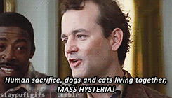
Notes:
So what can we do with all of this information?

Slide 38
Places to find me
https://github.com/gharmonjr/codemash
Twitter
@glennharmonjr
Instagram
@glennharmonjr
LinkedIn
Glenn Harmon Jr.

Slide 39
CoverMyMeds
Notes:
Be sure to stop by the booth

Slide 40
Thanks for stopping by

